Slide 1

Opening Doors to Ambitious Primary English
Melbourne School
December 2nd, 2024
Winner in the ‘best educational book’ category, educational resource awards 2017
Bob Cox, Author and Educational Consultant.
Director of ‘Searching for Excellence Ltd’
@BobCox_SFE
@openingdoors.bsky.social
www.searchingforexcellence.co.uk
bobcox@searchingforexcellence.co.uk

Slide 2
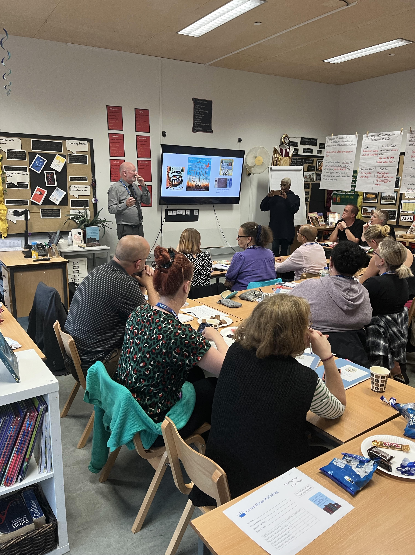

Principles and Strategies for Ambitious English

Slide 3

Opening Doors Network
Opening Doors Network – Searching for Excellence

Slide 4
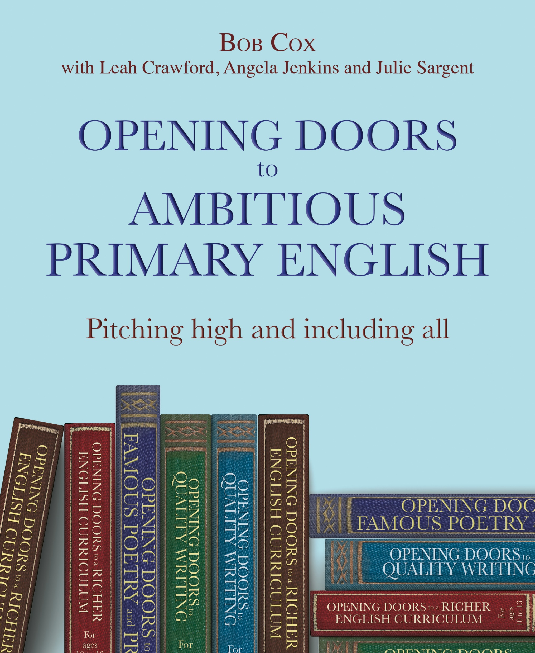
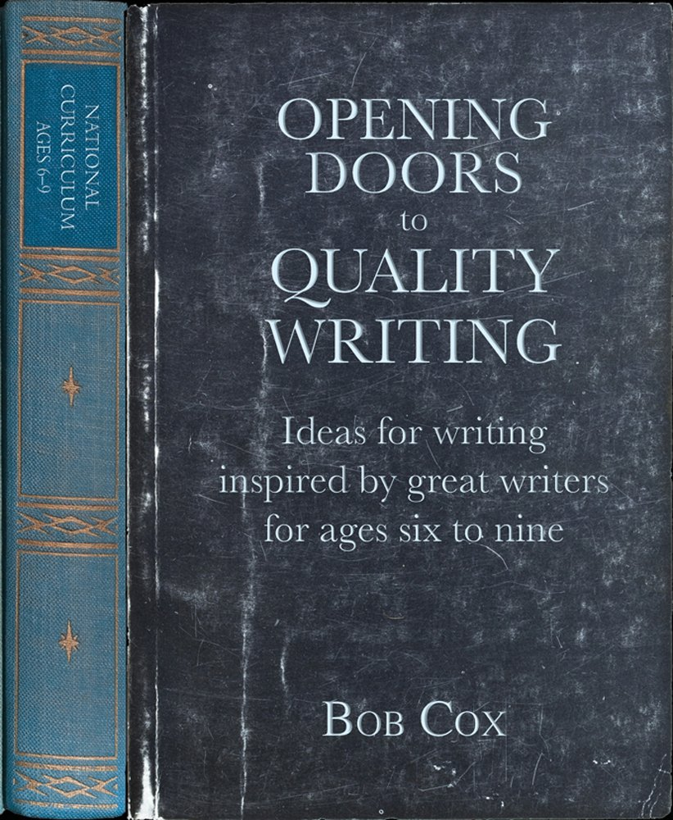
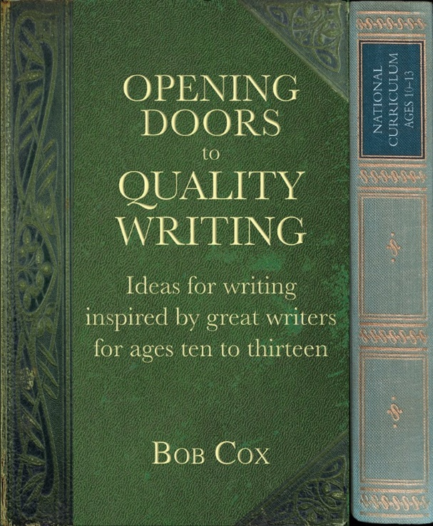



Principles and Strategies for Equity and Excellence
https://www.amazon.co.uk/s?k=9781785833984+%7C+9781785833977&ref=nb_sb_noss

Slide 5
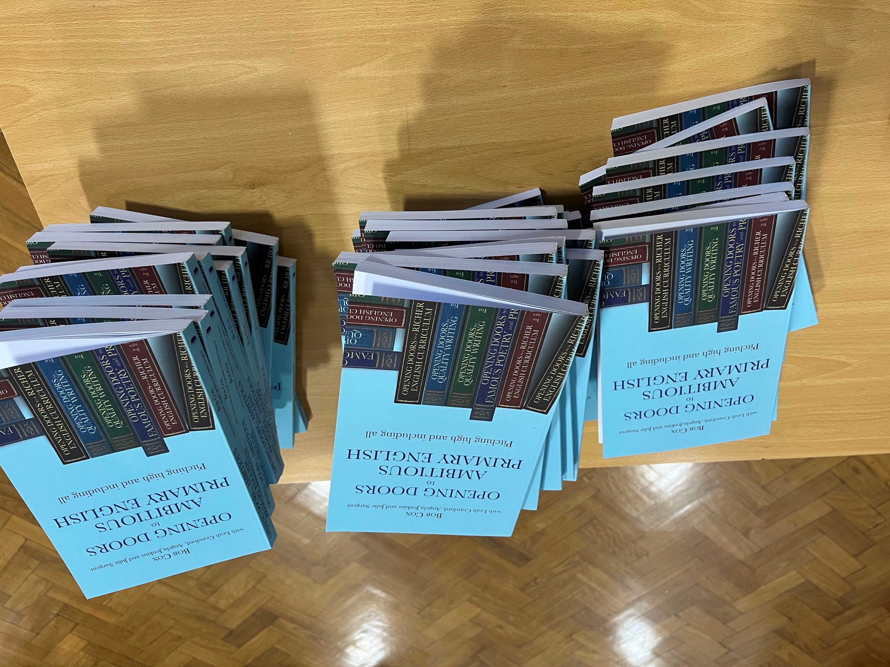
Quality Text to Quality Writing

Slide 6
Marty Woodlouse
The woodlouse was very crawly
He crawled right up my arm
Some kids are scared of these bugs though
He didn’t do me any harm
It is very hard to pick them up
They can curl into a ball
They could fall off anyone’s hands
They could hide behind a wall
My stripy woodlouse was very cute
Marty was his name
I had released him
When it started to rain
My mum didn’t want him
Living in our house
Our home is just for people
And not for my woodlouse!
Jonah Gordon-Walker
Wheatfield Primary, Wokingham.

Slide 7
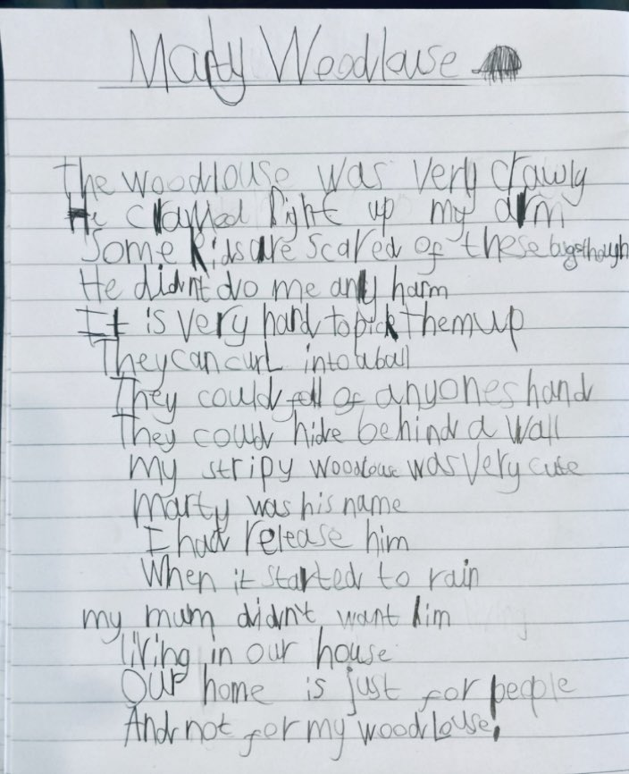

Slide 8
‘mood’ is sensed in reader response... it takes practice to search for it and feel it
Hurt no living thing:
Ladybird, nor butterfly,
Nor moth with dusty wing,
Nor cricket chirping cheerily,
Nor grasshopper so light of leap,
Nor dancing gnat, nor beetle fat,
Nor harmless worms that creep.
Christina Georgina Rossetti

Slide 9
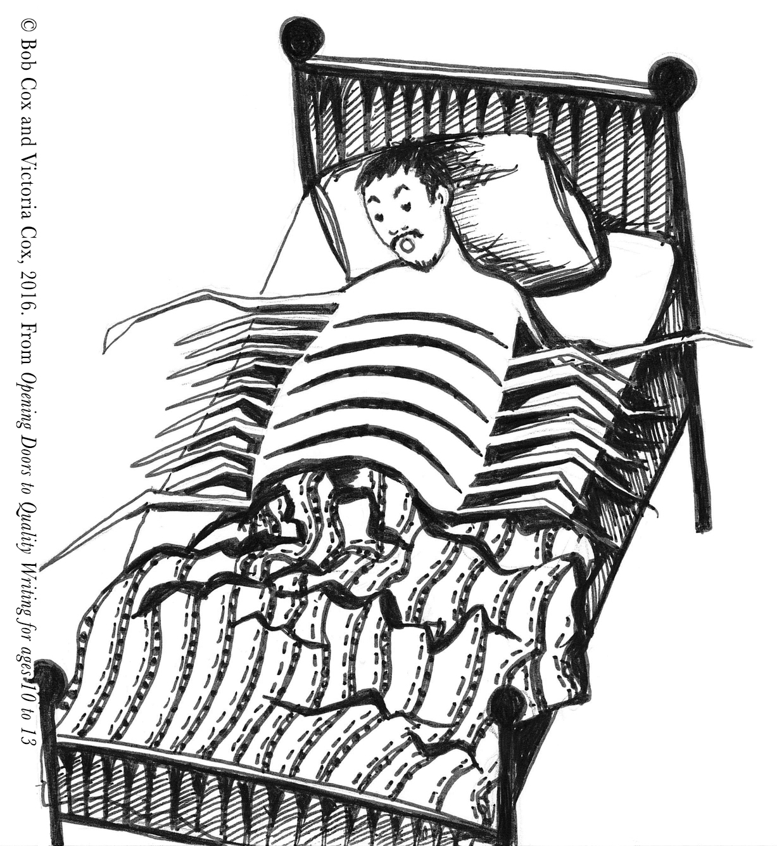

Slide 10
From ‘Metamorphosis’ by Franz Kafka
One morning Gregor Samsa woke in his bed from uneasy dreams and found he had turned into a huge verminous insect. He lay on his hard shell-like back, and when he raised his head slightly, he saw his rounded brown underbelly, divided into a series of curved ridges, on which the bedding could scarcely stay in place and was about to slip off completely. His numerous legs, which were pitifully thin relative to the rest of his body, wriggled helplessly in front of his eyes.
‘What has happened to me?’ he thought. It was not a dream.
Explore the precise description of the body:
underbelly
legs
back

Slide 11
Opening Doors to Quality Writing - Crown House Publishing
Gregor Samsa woke up sweating from uneasy dreams: he immediately felt that something was wrong. He opened his eyes, expecting to see his bland, peeling ceiling, but to his surprise, he saw his curtains and his wardrobe, which were on either side of his bed. ‘Huh,’ he thought, ‘What has happened?’. He lifted his head, and to his horror, a white, feather-covered body was spread out beneath him. Gregor Samsa was now a chicken!
Olive. Rossett Acre Primary School

Slide 12
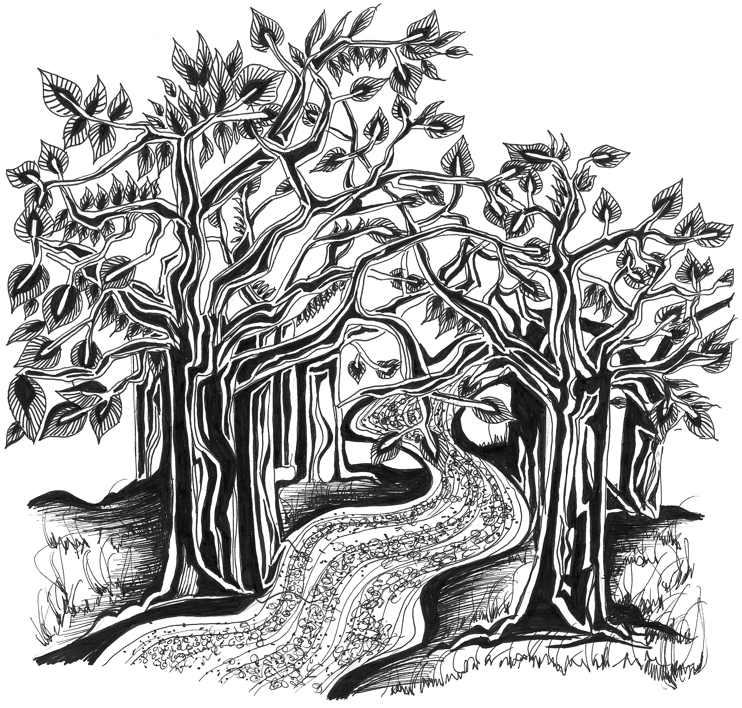

Slide 13
The Joy of Writing
From The Path by Chloe, Coastlands School. Year 5
Opening Doors to Famous Poetry and Prose - pupils work inspired by Part 1: Unit 5: Paths of Mystery - Crown House Publishing
Running between a forest and a village
Is the ghost of a meandering path
That, in days long passed,
served the milkman
With his horse, cantering back
From a hard day’s work;
Foxes that paced, preparing to catch
Their dinner, as the grand old owl
Whistled to his mate

Slide 14
From ‘The Path’ by Edward Thomas
To see a child is rare there, and the eye
Has but the road, the wood that overhangs
And underyawns it, and the path that looks
As if it led on to some legendary
Or fancied place where men have wished to go
And stay; till, sudden, it ends where the wood ends

Slide 15
Ambition and Scope of the Text
Using Concepts
Quality Writing
Style imitation
Taster draft editing, learning, improving
Tuition
Tasters as frames for sustained writing
Quality Text
Zoom in on Language Study
Taster Draft
Chunk the Knowledge
Link in whole text reading
Adapt ‘Opening Doors’ to your context. OD is not a version of the English curriculum; it’s principles and strategies
Doors are Opening

Slide 16
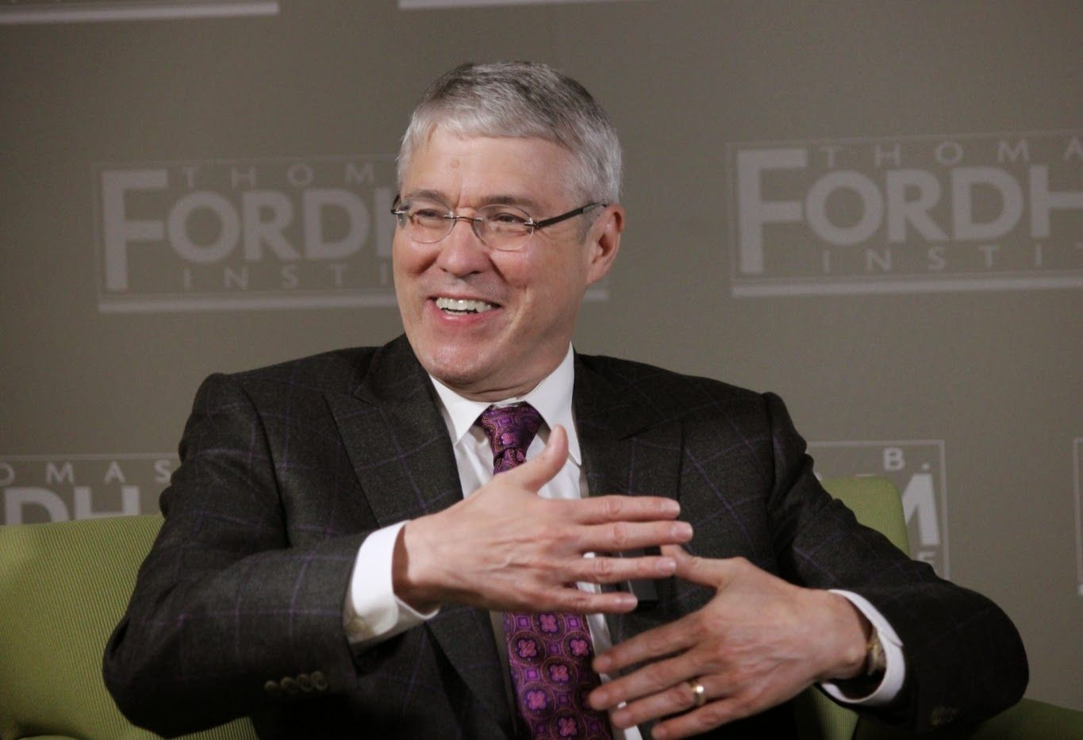
Prof. Timothy Shanahan
University of Illinois
If you really want your kids to excel in reading, get them challenging texts. Then engage them in discussions of those texts. Get them to write in response to the texts.
Do You Have a Pet Peeve about Reading? Here Are My Top Ten (Pt. 2) | Shanahan on Literacy

Slide 17
Chapter 7, page 80
Writing can be at the centre of the curriculum on a daily basis and integrated coherently alongside speaking, listening and reading.

Slide 18
An Emerging Rationale for Challenging Texts
Using an easily accessible text
Using visuals for delightful observations
Using texts to deliver single aspects of English
Using accessible texts to read aloud
Using accessible texts for comprehension questions
Using a more challenging text with an increasing range of access and intervention strategies
Using visuals to deepen understanding and develop vocabulary, ideas and writing
Using challenging texts to read aloud
Using challenging texts to improve reading and comprehension
Using challenging texts as the context for instruction, spg teaching and learning dialogues
TALK
From doors ajar
To doors opening

Slide 19
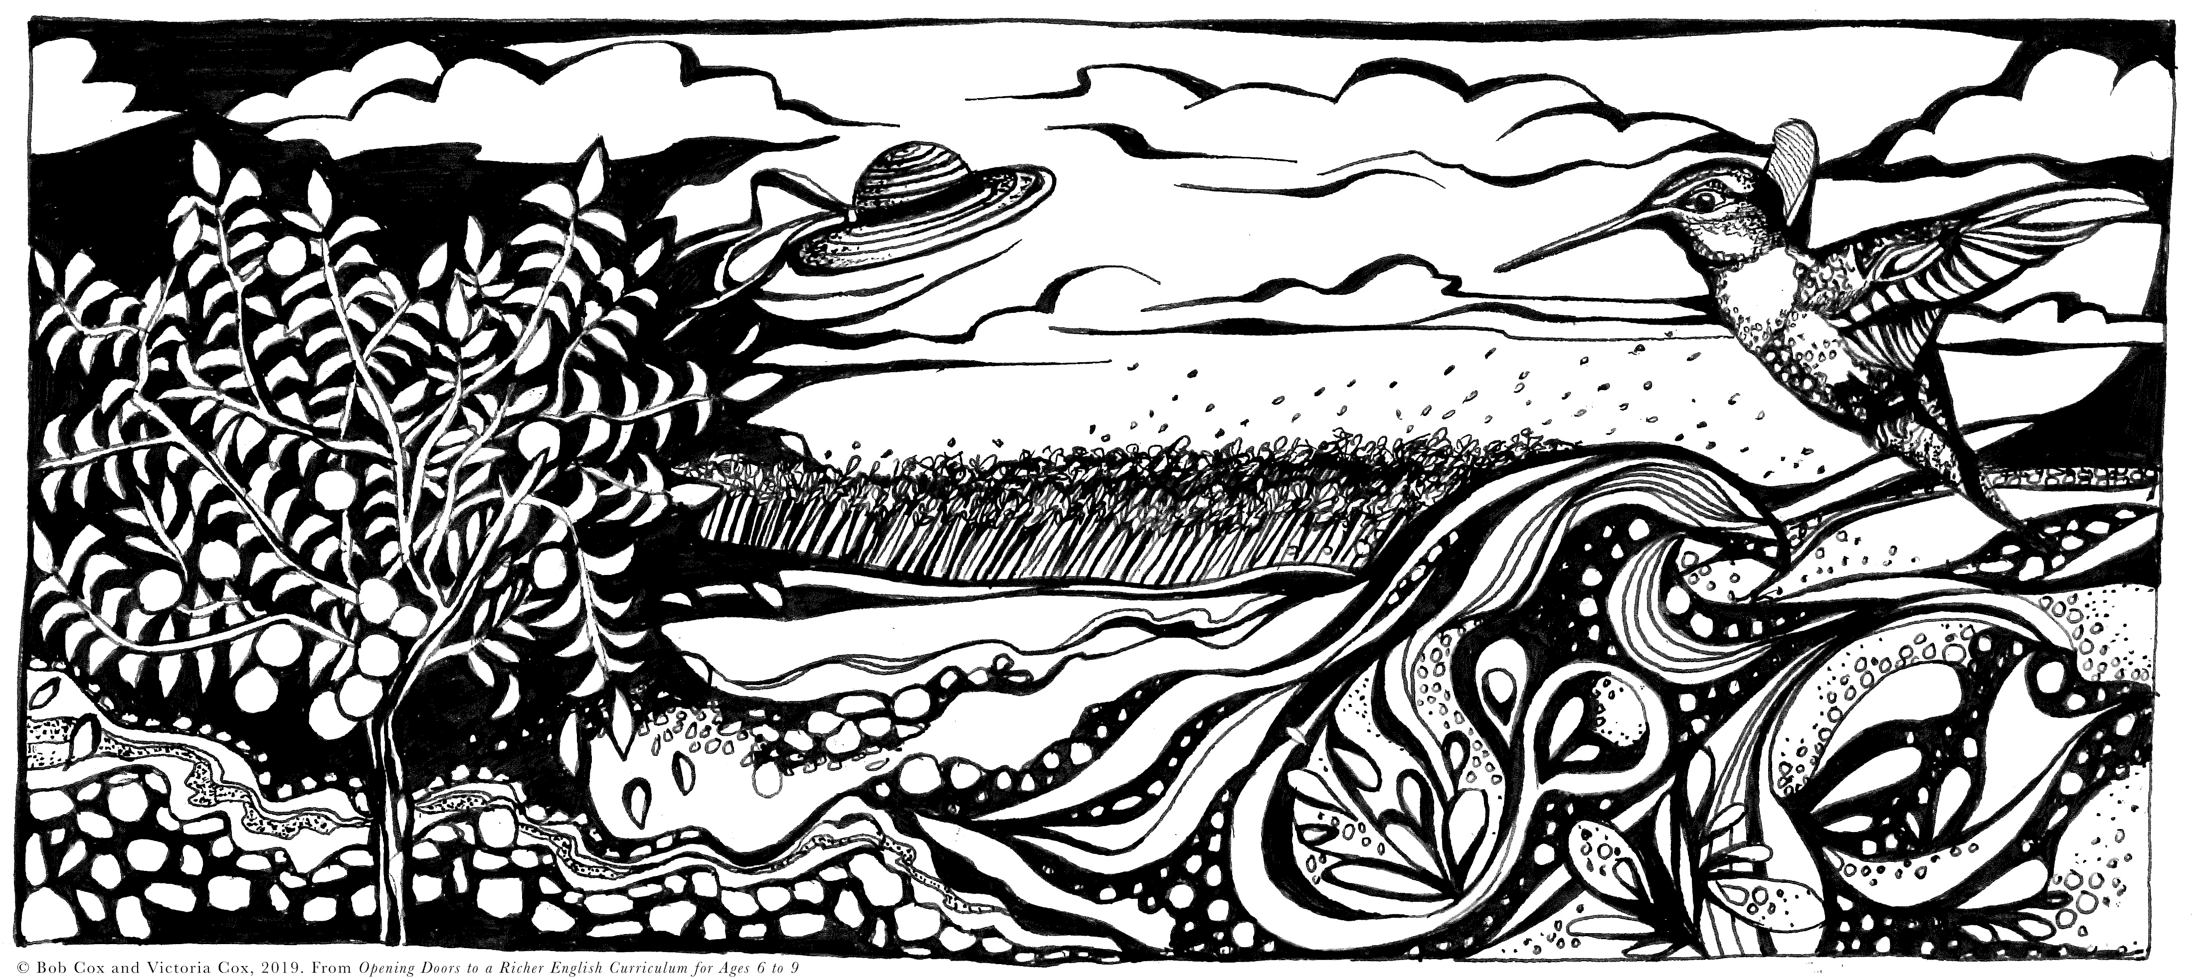
I pulled a hummingbird out of the sky one day
but let it go,
I heard a song and carried it with me
on my cotton streamers,
Concept: effective personification
Wind by Dionne Brand

Slide 20
From Sydney Wind by Joe Foxall,
Charlbury Primary
I started as a tiny breeze,
I rustled the strings of a child’s hair,
I became stronger as the day passed by,
I flew through the night
I heard the call of an owl welcoming chicks to his nest,
plus the howling of wolves hunting down their prey,
in hours the sun rose again,
a smell wafted up to me,
in my dreams,

Slide 21
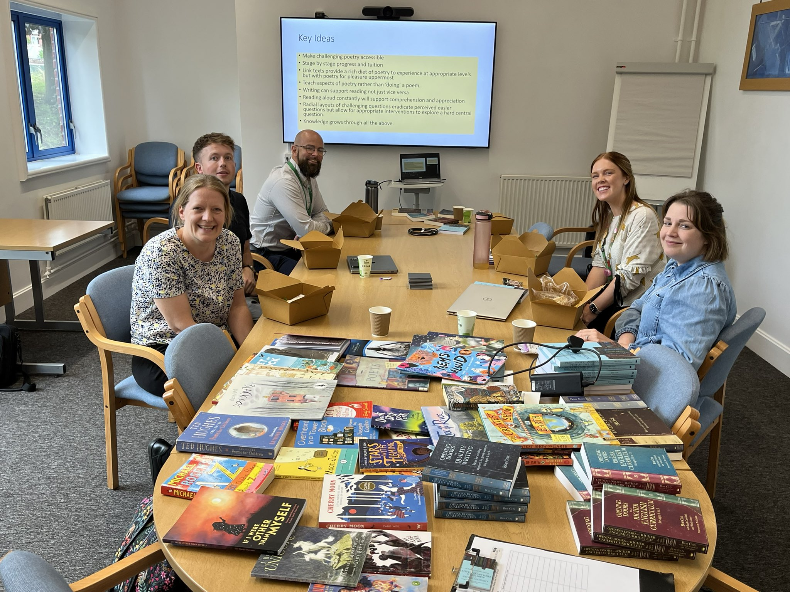
Detailed Case Study

Slide 22
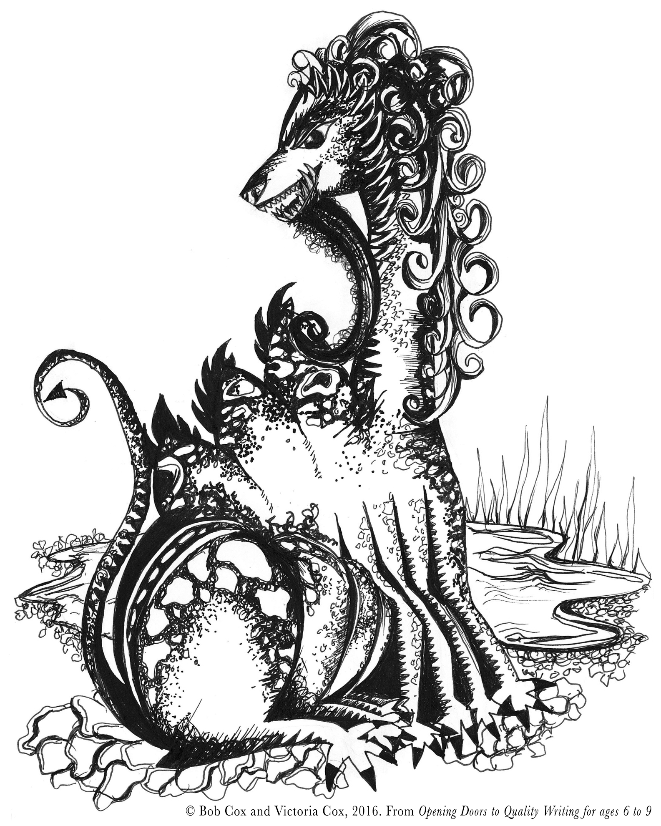

Slide 24
Frightening or Funny?
Opening Doors Continuum Lines

Slide 25
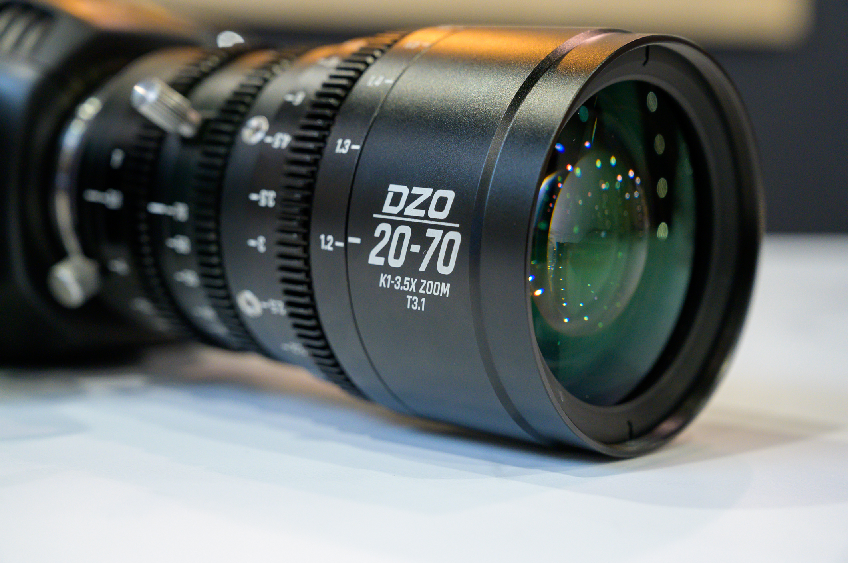
The Zoom in Effect

Slide 26
Vocabulary and Meaning
Concept: Image-Making
Then how the creature stamps and roars
Along the Ump’s resounding shores!
The drowsy cattle faint with fright;
The birds fall flat, the fish turn white
Noticed, Noted, Not Sure

Slide 27
White
ivory
snowy
pale
blank
Innocence, new, unblemished snow
White with fear
White heat – extreme temperature
Heavenly, white clouds

Slide 28


Concepts
Extended Metaphor
Building Tension
Narrative Technique
Effective Personification
Effective Characterisations
Epic Style

Slide 29
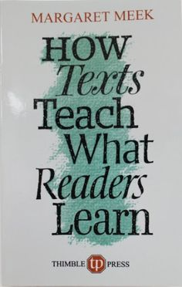
From ‘How Texts Teach What Readers Learn’ by Margaret Meek quoted in ‘Opening Doors to Ambitious Primary English’
If we want to see what lessons have been learned from the texts children read, we have to look for them in what they write.

Slide 30
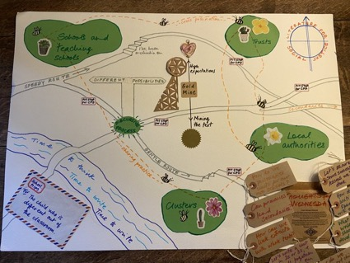
Taster Draft

Slide 31
Taster Drafts - Predictions
Develop the setting – the valley of the Ump
Develop the movement of the Hippocrump – what happens?

Slide 32
The Meaning is in The Reading
Along the valley of the Ump
Gallops the fearful Hippocrump.
His hide is leathery and thick;
His eyelids open with a Click!
His mouth he closes with a Clack!
He has three humps upon his back;
On each of these there grows a score
Of horny spikes, and sometimes more.
His hair is curly, thick and brown;
Beneath his chin a beard hangs down.
He has eight feet with hideous claws;
His neck is long – and O his jaws!
The boldest falter in his track
To hear those hundred teeth go Clack!
The Hippocrump is fierce indeed,
But if he eats the baneful weed
That grows beside the Purple Lake,
His hundred teeth begin to ache.
Objective: Can you understand how James Reeves creates a ‘prefabulous animile’?

Slide 33
Deep Objectives
Can you begin to understand how a poet creates an original fantasy creature?
Knowledge
Learning how to learn
Inventing proper nouns
Alliteration effects
Linking meaning – fear!
Verb choice
Word depth – ‘white’
Thinking engines
Visuals
continuuum lines
reflection
Oracy

Slide 34
Name and Describe the ‘Prefabulous Animile’
Body
Teeth
Rich language,
High pitch.
Access Strategies
Write a line or a verse for each part of the body.
A poem emerges
Humps
Beard

Slide 35
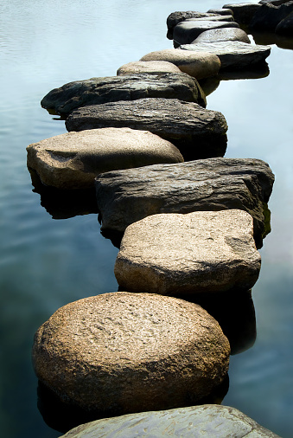

Slide 36
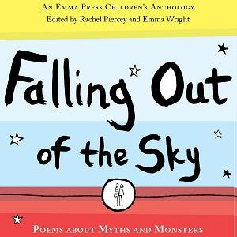
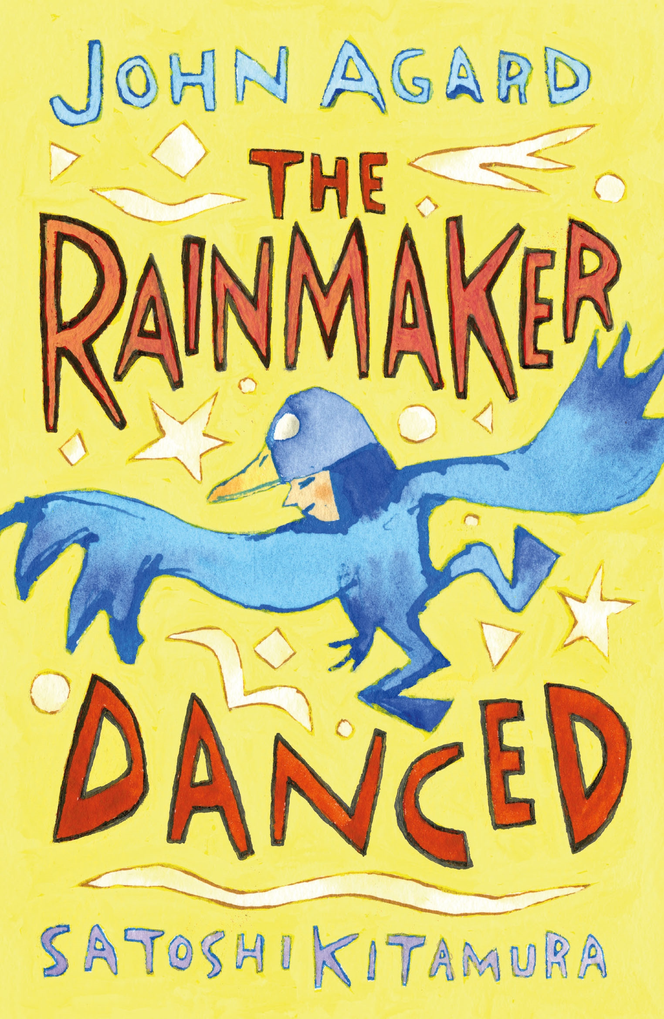
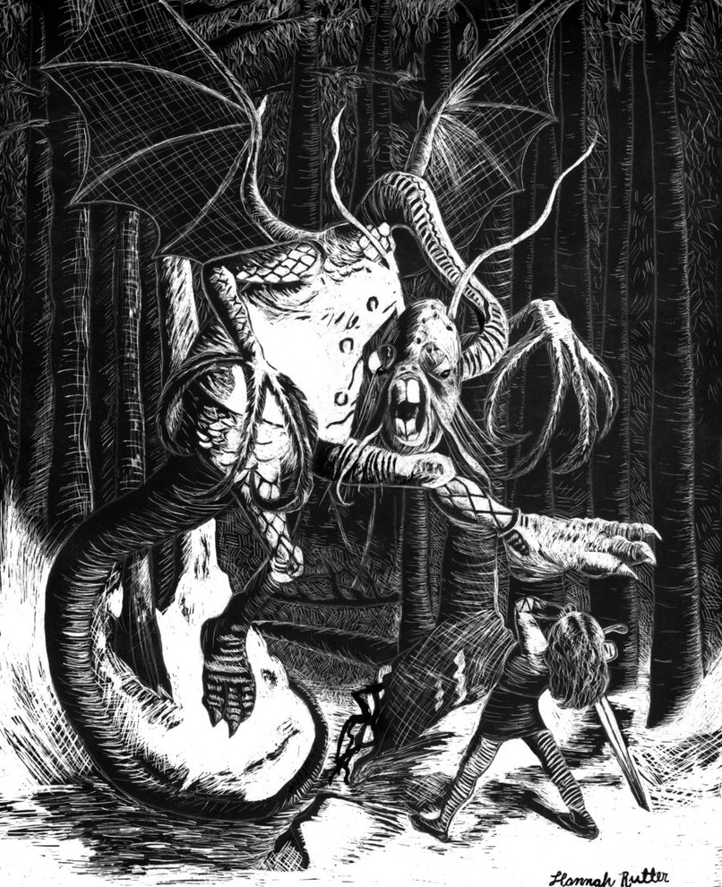
Link Reading

Slide 37
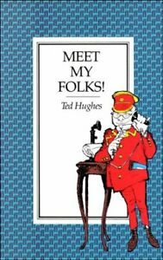
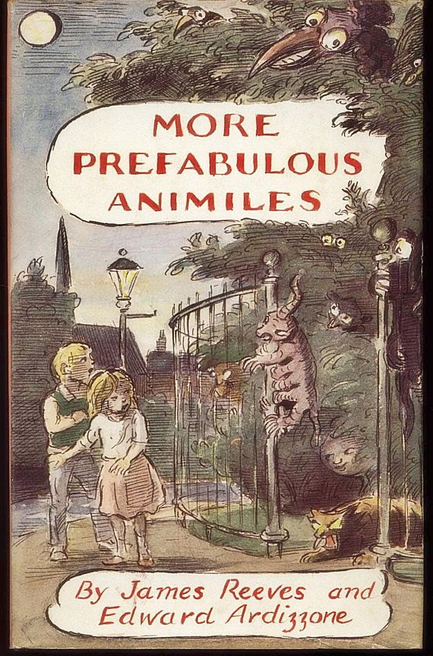
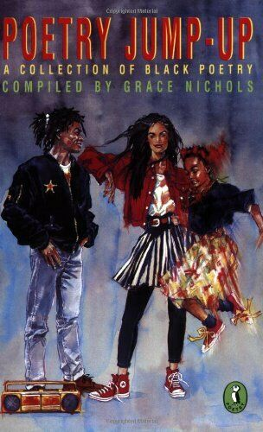
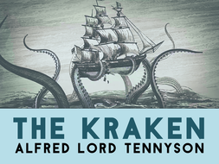
Link Reading
Anancy Spider by Andrew Salkey

Slide 38
Wings to Fly Writing
Can you create your own fantasy creature?
James Reeves calls his collection ‘Prefabulous Animiles’
Use the parts of the body of The Hippocrump explored in the access strategies to help you plan the content for different stanzas in your poem about a new ‘animile’
Mouth
Eyelids
Humps
Hair
Chin
Claws
Neck
Teeth

Slide 39
Other Writing Ideas: images feed imagination
His hair is curly, thick and brown;
Beneath his chin a beard hangs down.
But if he eats the baneful weed
That grows beside the Purple Lake,
His hundred teeth begin to ache.
Write your own hairy verse!
Create a Crimson Lake with unusual plants. Instead of harmful, the plants must be healthy.

Slide 40
From chapter 7, page 80
‘Opening Doors to Ambitious Primary English’
Imitating an author’s style and making some early attempts to experiment with a concept can significantly support children’s routes to comprehension. Tasters can also provide a focused vehicle for assessment for learning, enabling the teacher to teach to need and devise writing processes that enable the children to aspire towards a sustained and summative piece.

Slide 41
Pupils’ work unit links
Bob Cox - Crown House Publishing
Part 1: Opening doors to prose
1. Night Encounter – The Woman in White by Wilkie Collins
2. Spooky Scientists! – The Phantom Coach by Amelia B. Edwards
3. The Strongest Looking Brute in Alaska – That Spot by Jack London
4. Mr Knickerbocker's Notes – Rip Van Winkle by Washington Irving
5. The Portrait of Doom – Tess of the D'Urbervilles by Thomas Hardy
6. The Hell Hound – The Hound of the Baskervilles by Sir Arthur Conan Doyle
7. Sinister Spaces – Metamorphosis and The Castle by Franz Kafka
8. The Mirror and the Window – Wuthering Heights by Emily Brontë
Part 2: Opening doors to poetry
9. All in This House is Mossing Over 'From Mementos' by Charlotte Brontë
10. Dancing the Skies 'High Flight' by John Gillespie Magee, Jr
11. The Mystery of the Lonely Merman 'The Forsaken Merman' by Matthew Arnold
12. Making Magic Talk 'The Magnifying Glass' by Walter de la Mare
13. The Spirit in the Garden 'A Garden at Night' by James Reeves
14. A Shropshire Lad 'Blue Remembered Hills' by A. E. Housman
15. The Silver Heel 'I Started Early 'Took My Dog' by Emily Dickinson
The Opening Doors to Quality Writing series won the 2017 Education Resources Awards in the Educational Book Award category.

Slide 42
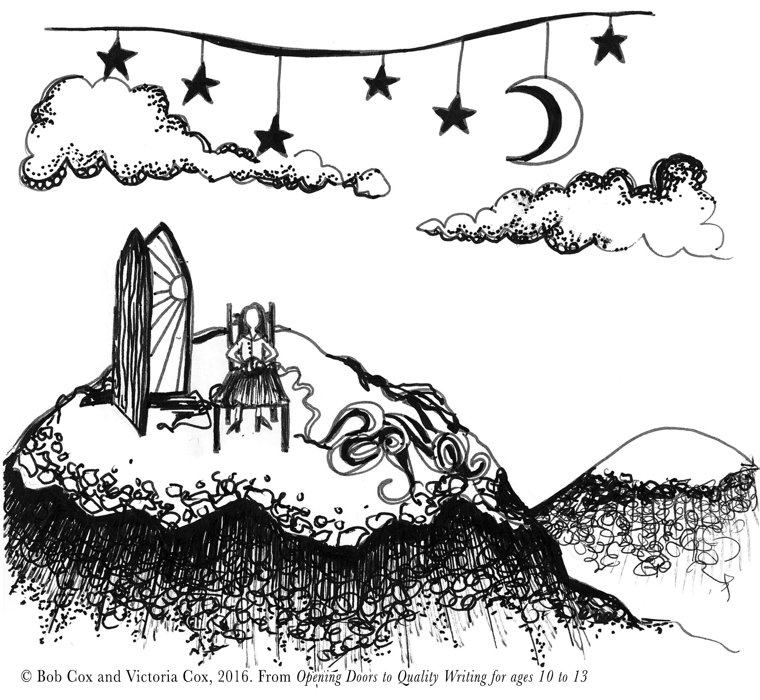
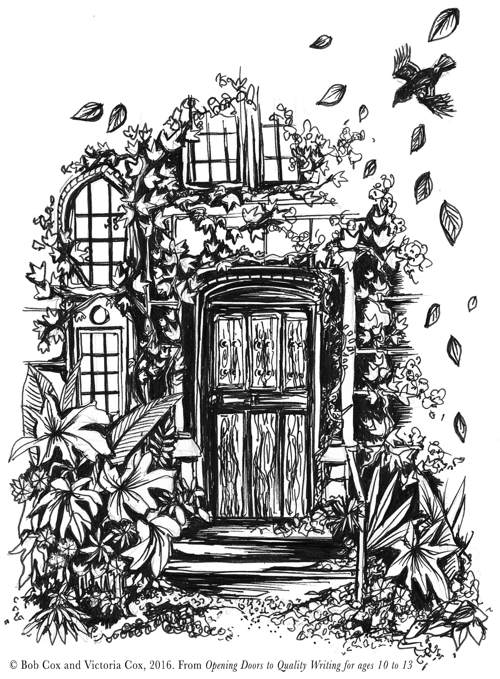
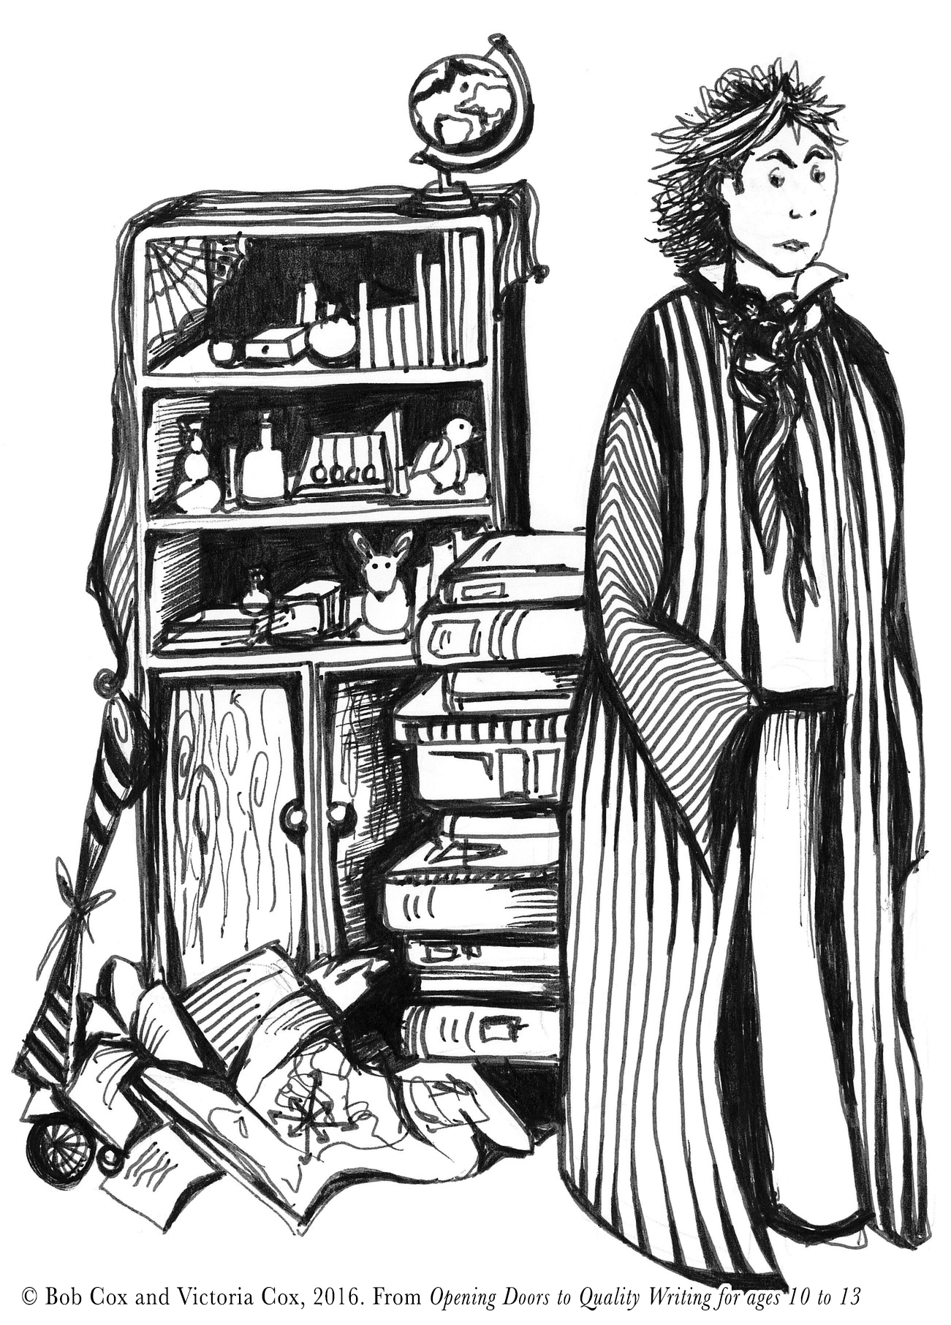
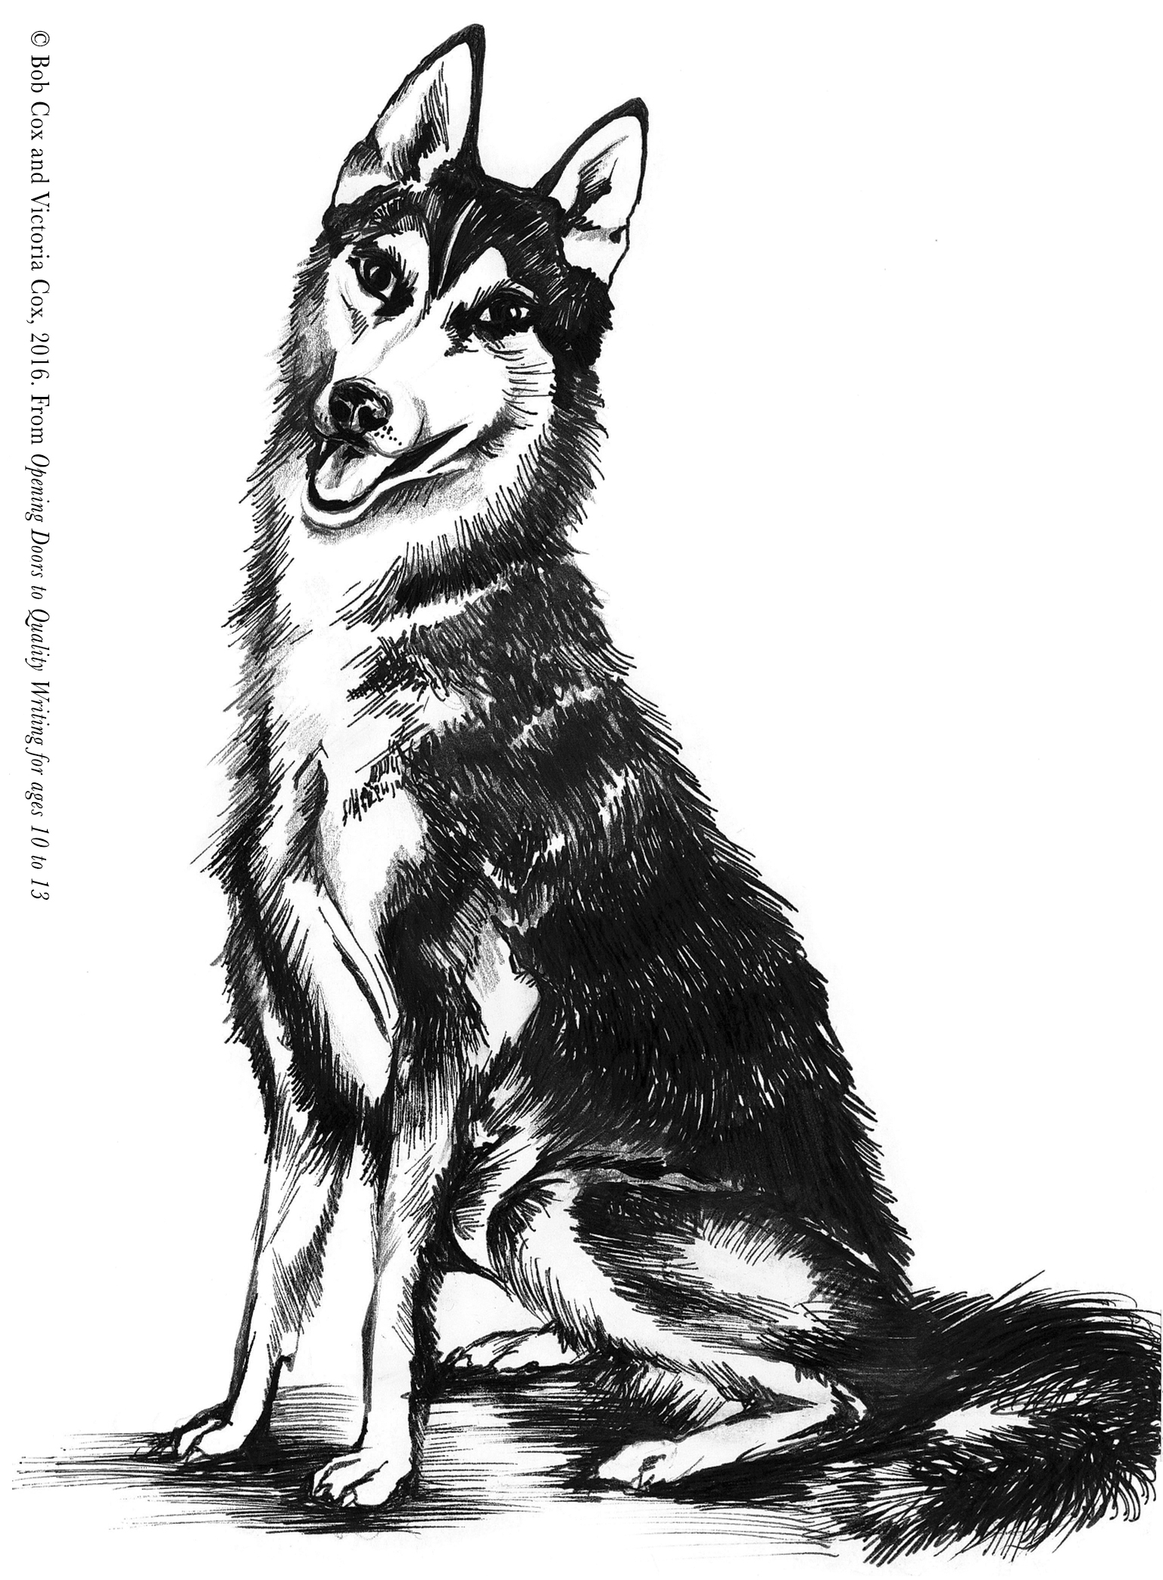


Slide 43
Mary Myatt’s foreword
I believe there is a tendency in the sector to make things too easy for too many of our pupils, whatever their prior attainment, in the mistaken belief that they can’t cope. They can!
In working in this way, pupils get better not just at reading, but also speaking, listening and writing. Most importantly, they fall in love with beautiful texts too

Slide 44
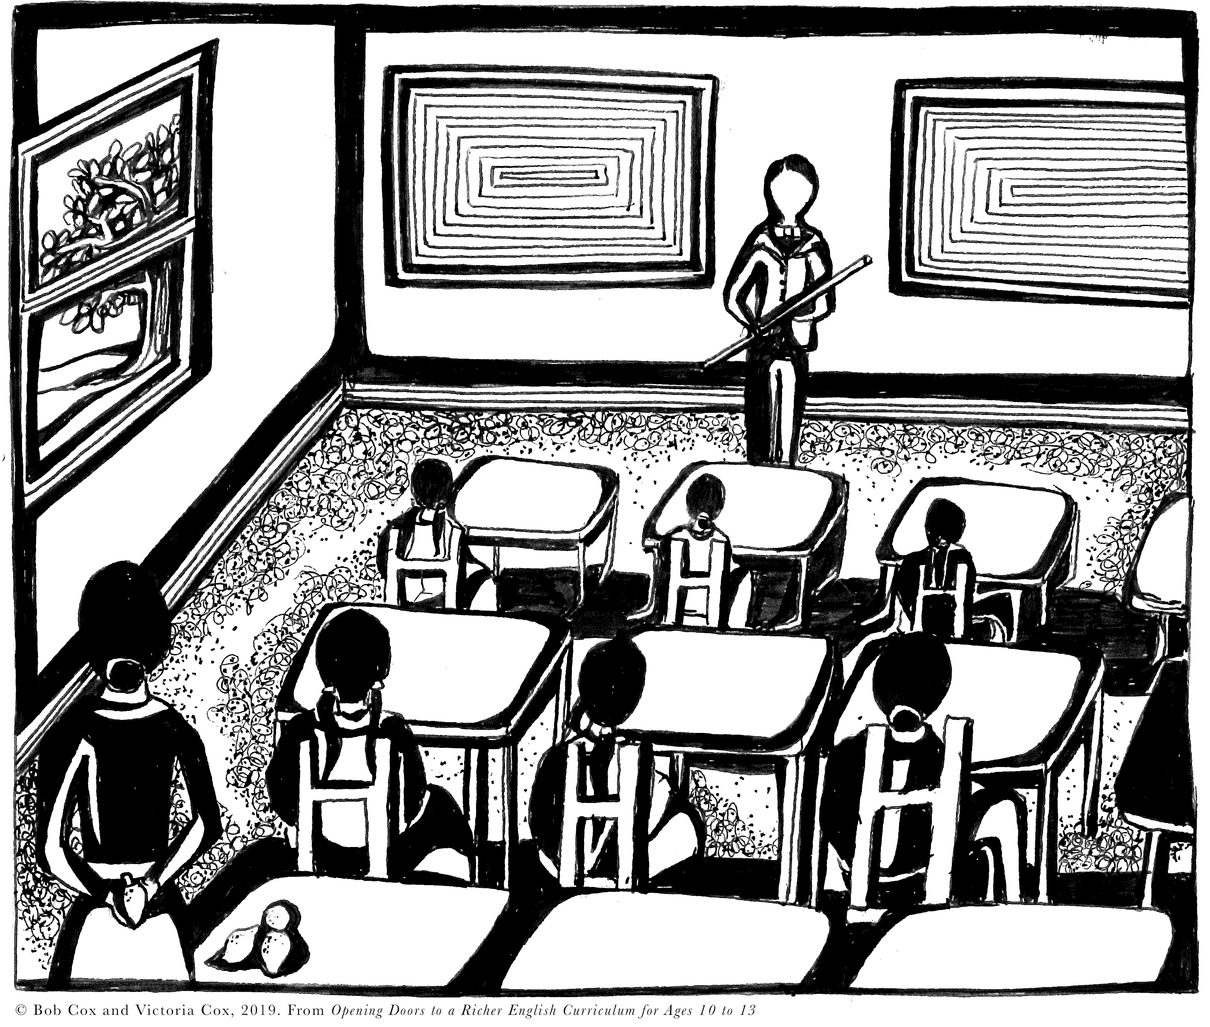
Little Women by Louisa May Alcott
Context
Amy March has taken some pickled limes into school. However, sucking them has become such a craze that the teacher, Mr Davis, has banned them. Amy owes limes to other girls and is planning to pay them back. However, a rival pupil, Jenny Snow, gives away the presence of her limes and Amy must face the consequences.

Slide 46
Noticed, Noted, Not Sure
It was a most unfortunate moment for denouncing Amy, and Jenny knew it. Mr Davis had evidently taken his coffee too strong that morning; there was an east wind, which always affected his neuralgia; and his pupils had not done him the credit which he felt he deserved: therefore, to use the expressive if not elegant language of a schoolgirl, ‘he was as nervous as a witch, and as cross as a bear’. The word ‘limes’ was like fire to powder; his yellow face flushed, and he rapped on his desk with an energy which made Jenny skip to her seat with unusual rapidity.
‘Young ladies, attention, if you please!’
At the stern order the buzz ceased, and fifty pairs of blue, black, grey and brown eyes were obediently fixed upon his awful countenance.
‘Miss March, come to the desk.’
Red = is there a connotation in ‘strong’?
Blue = direct speech command!
Green= vocabulary and questions over ‘yellow’
Notes:
Out of slides: word depth and half understanding plus opportunities or plagues

Slide 47
The drama continues……..
Amy rose to comply with outward composure, but a secret fear oppressed her, for the limes weighed upon her conscience. ‘Bring with you the limes you have in your desk,’ was the unexpected command which arrested her before she got out of her seat. … (Mr Davis insists that Amy throws the limes out of the window two by two!) As Amy returned from her last trip, Mr Davis gave a portentous ‘Hem!’ and said, in his most impressive manner –
‘Young ladies, you remember what I said to you a week ago. I am sorry this has happened; but I never allow my rules to be infringed, and I never break my word. Miss March hold out your hand.’

Slide 48
Mr Ball has taught geography at Cane Bridge School ever since the school was built.
He always wears the same highly-polished brown brogues and combs his unhealthy hair back the same way every day. His suit and tie are so tight that his big bull-neck hangs over his white shirt. This startling white shirt only emphasises how red his fierce face is. In the centre of this raging redness is a broad nose with flaring nostrils. His eyes, half-covered by his heavy eye lids, are dull green.
Although his eyes move slowly, they see everything: a child not doing their work; a child whispering to the person in front of them; even the child who dares to briefly look him in the eye.
Jack Scanlon
Richmond Hill Academy, Doncaster

Slide 49

Other ideas for quality text to quality writing
Captions
Mapping sentences on to pictures
Including language via questions
Start with a picture from the end
Predictions
All taster drafts give scope for editing, correcting, learning, creating, imagining.

Slide 50
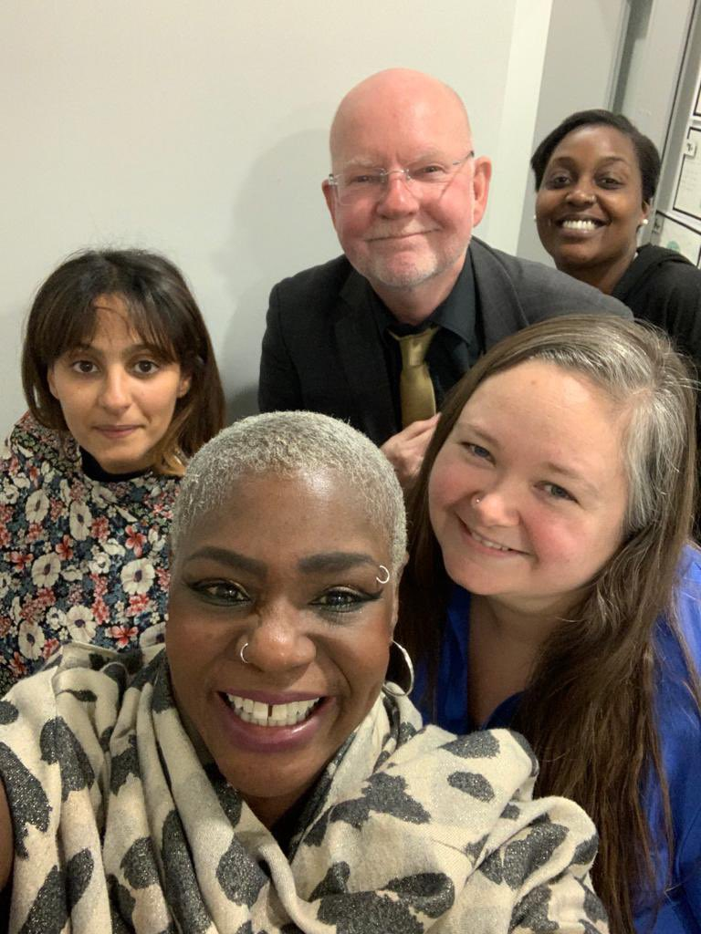
Overviews

Slide 51
From ‘The Wonder Institute News’ by Kirsty McMurdo, TL Leader May 2024
One-Family-Issue-16_compressed.pdf (wlp.education)
Five Key Concepts around ‘Opening Doors’
Pitch lessons beyond the level of the most advanced
Scaffold and intervene as appropriate
Link quality texts from the past to the present and across the globe
Exploit the potential of literature, including poetry, to give scope for new learning and deep knowledge acquisition as well as general knowledge
Plan for sequencing and progression of knowledge via concepts in English

Slide 52
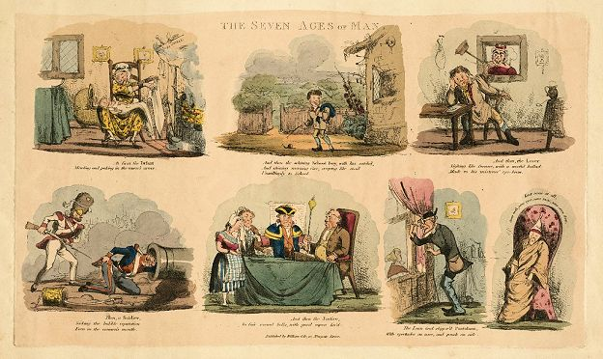
Free Unit from Leah Crawford
Seven Ages of Man
Opening Doors to Shakespeare – ThinkTalk – Leah Crawford

Slide 53
Free Resources
Video Lessons (15 mins)
Opening Doors Online Learning Resources – YouTube
Latest Article
Challenging texts – Why using them benefits all – Teachwire
Choosing a Core Text via NATE (National Association for the Teaching of English)
Free Resources – Searching for Excellence
Interview with teachers via The English Association
Opening Doors to Ambitious English | The English Association

Slide 54
Principles and Strategies for Equity and Excellence
https://www.amazon.co.uk/s?k=9781785833984+%7C+9781785833977&ref=nb_sb_noss

Slide 55
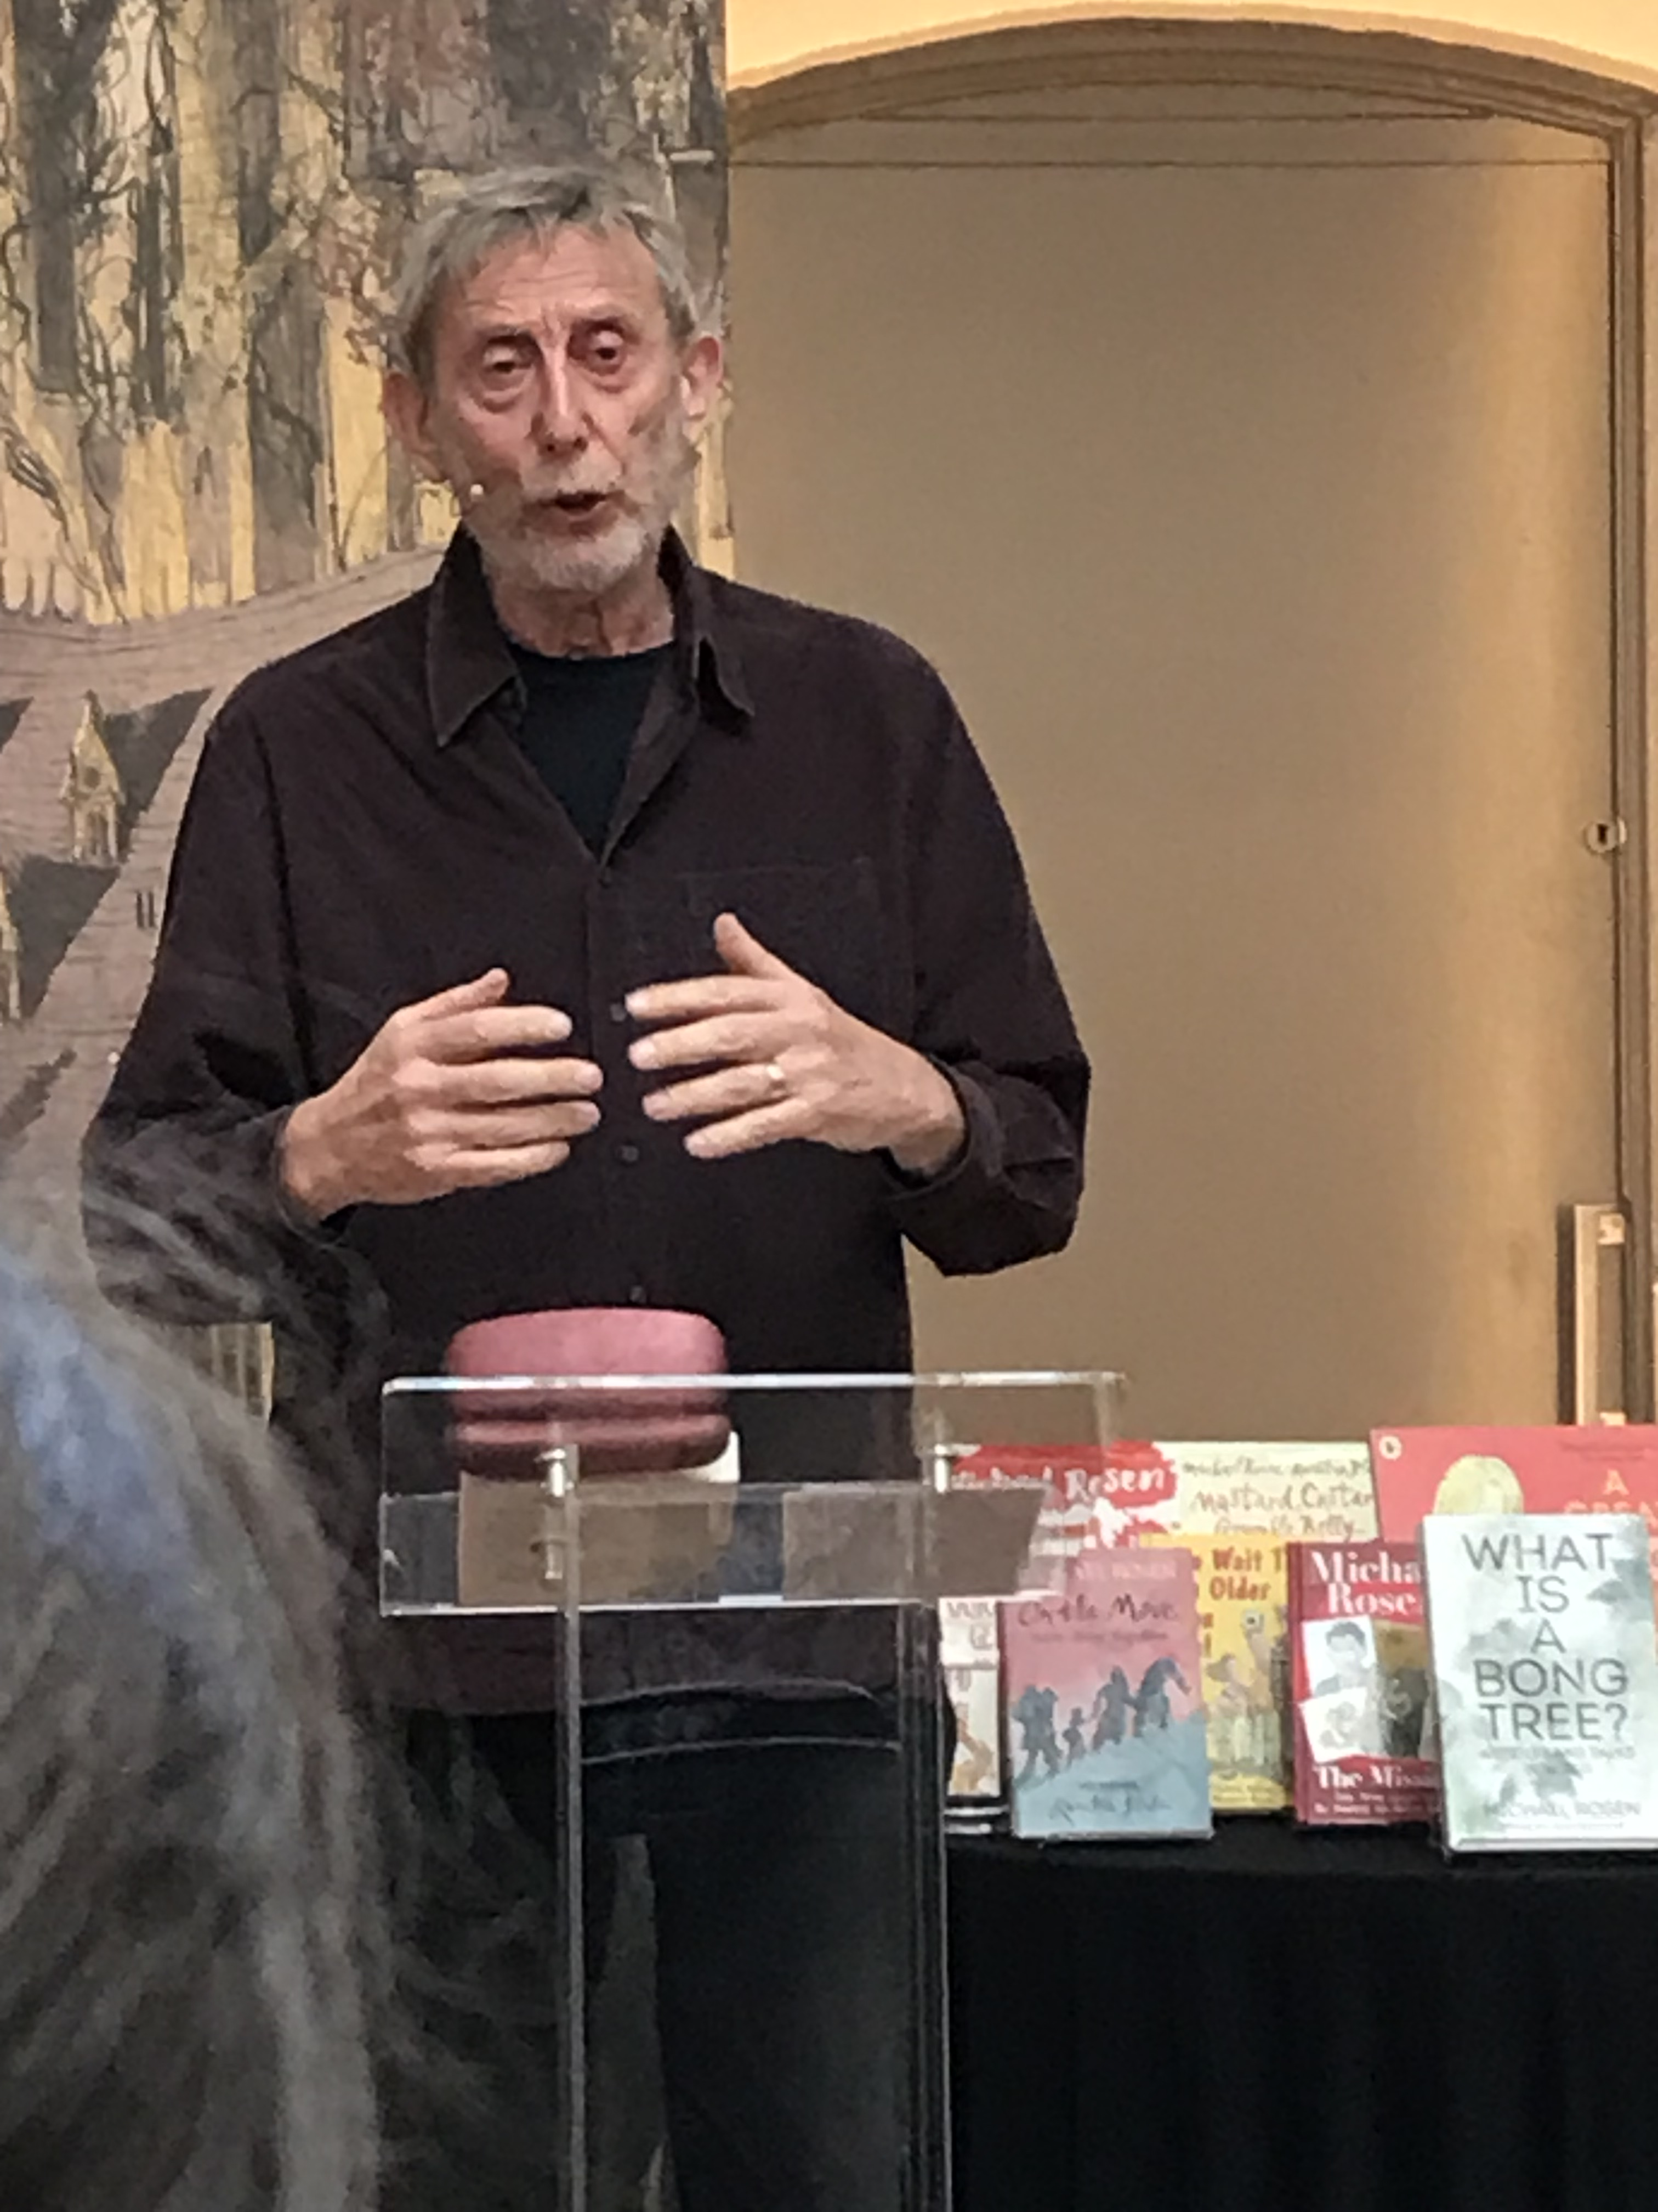
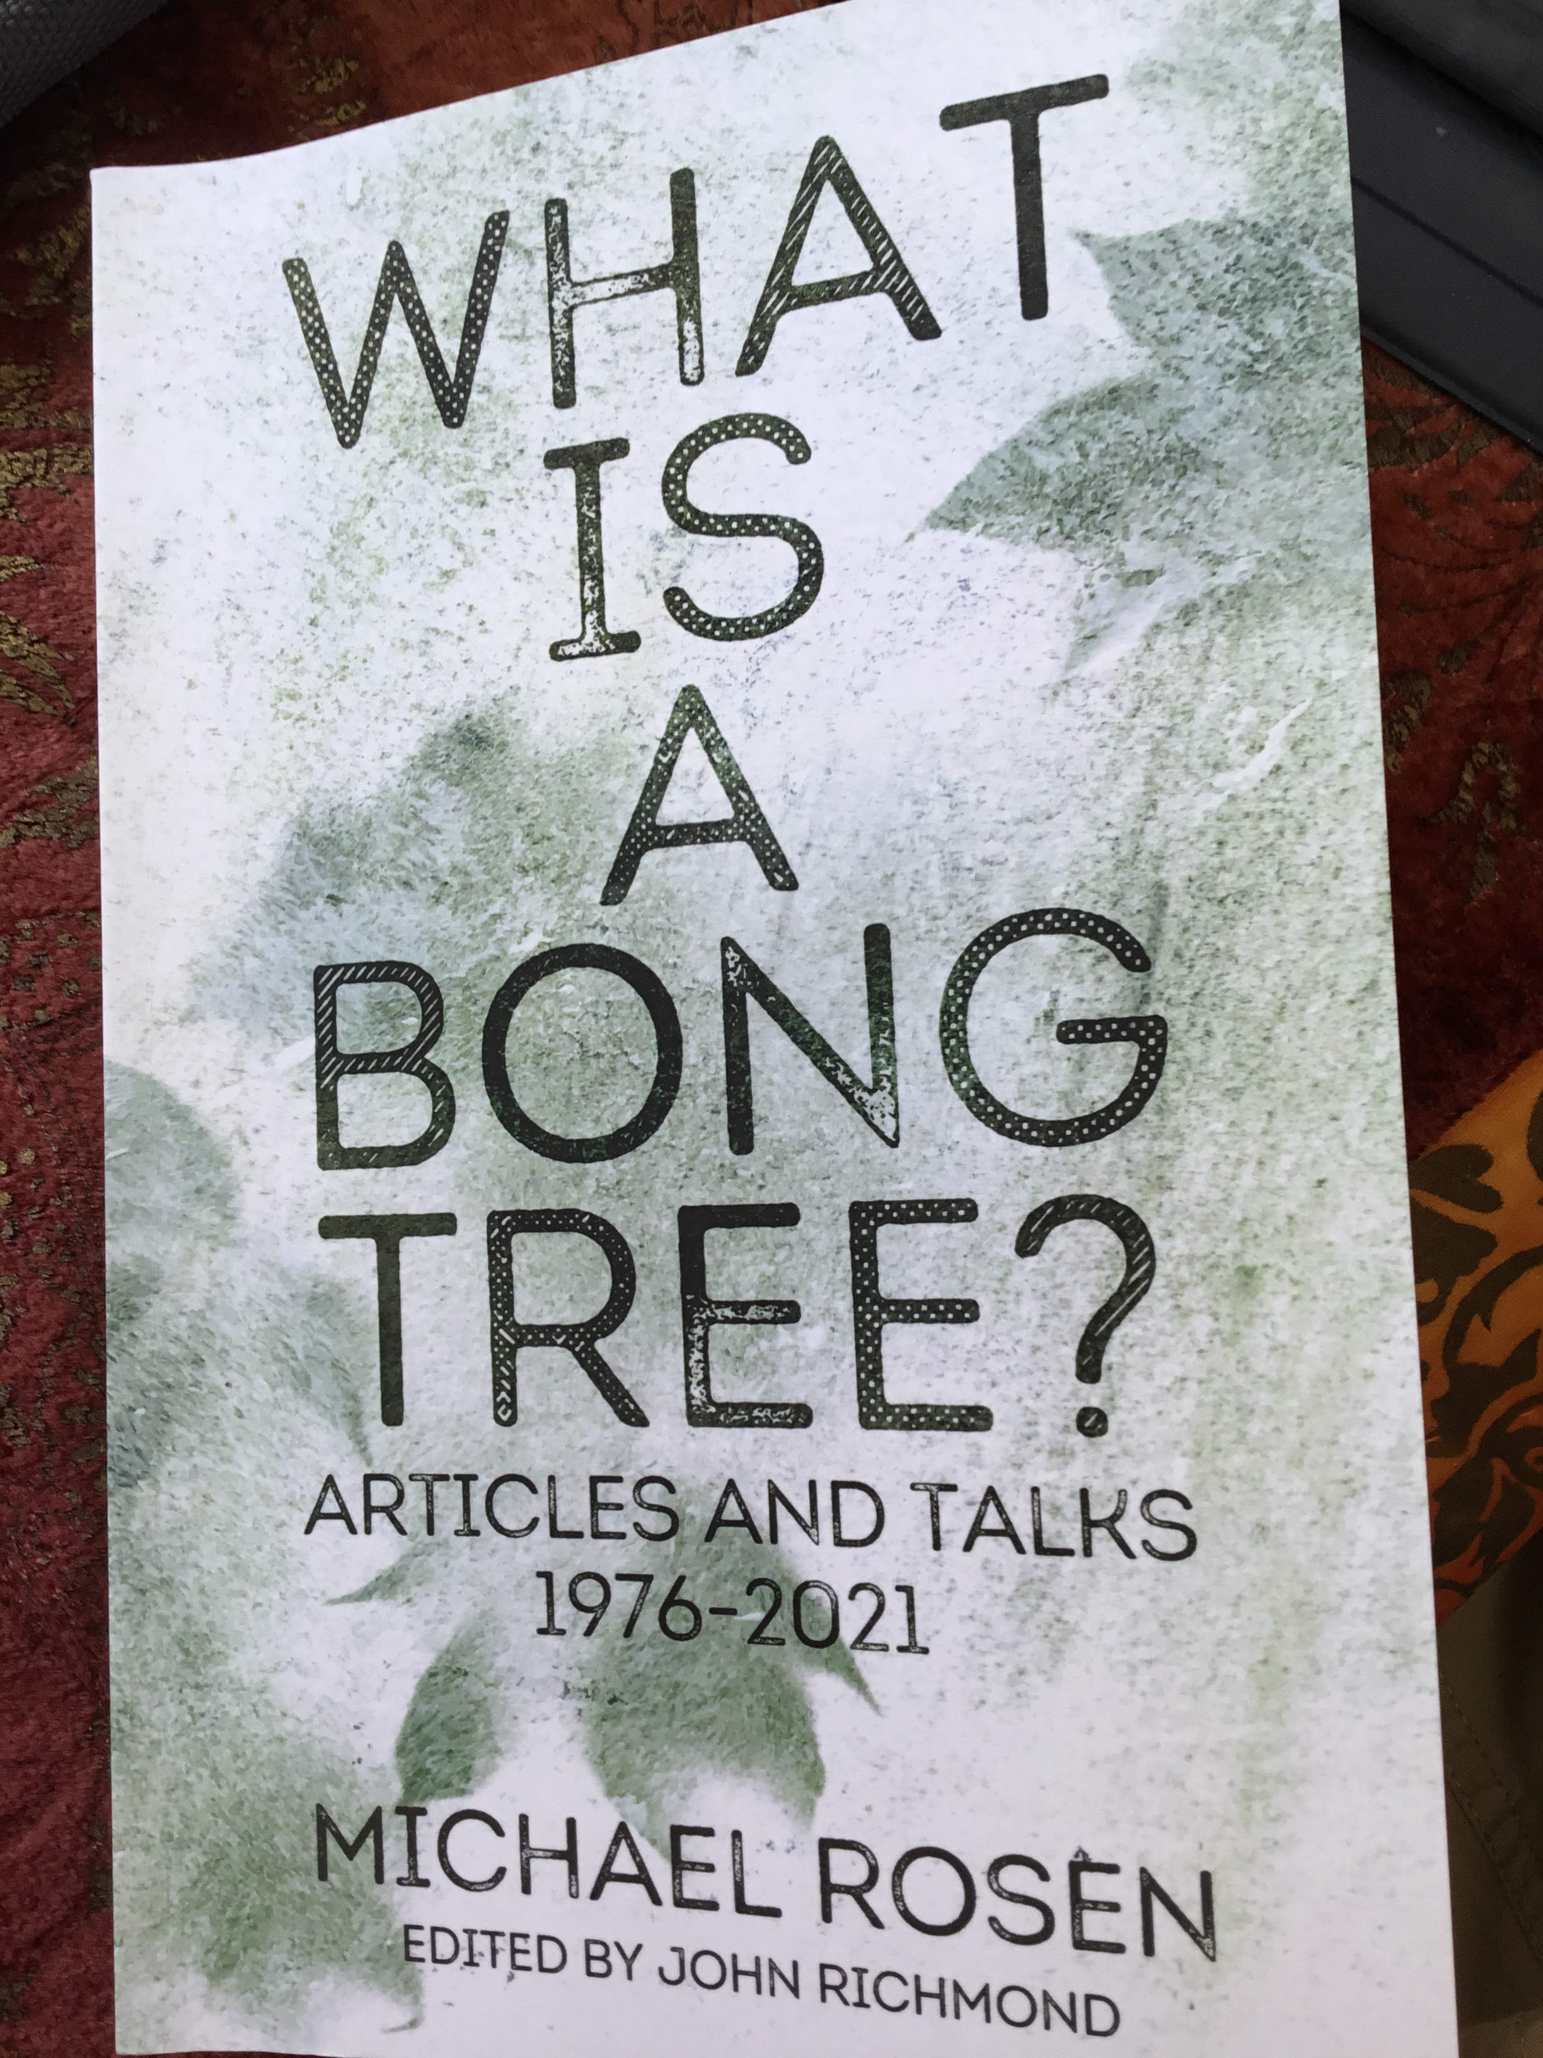
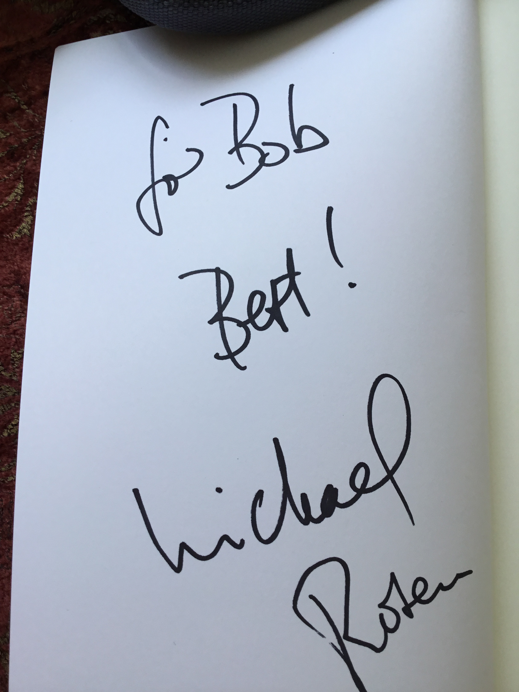

Slide 56
From The Owl and the Pussycat by Edward Lear
They sailed away, for a year and a day,
To the land where the bong-tree grows;
And there in a wood a Piggy-wig stood,
With a ring at the end of his nose,
His nose,
His nose,
With a ring at the end of his nose.

Slide 57
From What is a Bong Tree by Michael Rosen.
P315 Lecture 2007 at the Centre for Language in Primary Education
Like the phrase ‘Bong Tree’, the words signify something , but the only way I can access this meaning is to find out how they chime with what I’ve read and what I know and what I’ve felt and what I’ve done.

Slide 58
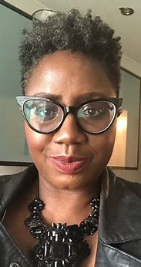
From the Foreword to Opening Doors to Ambitious Primary English
Exposing our children to high-quality texts is like giving them a gift. Once unwrapped, the opening up of their imagination, through the power of words and illustrations, is a sight to behold. For me, this literary gifting should never be the preserve of the favoured few. I am wholly convinced that it must be available to every child, regardless of the circumstance.
Sonia Thompson, Headteacher of St Mathews C of E Primary School

