Slide 1


An evaluation of Opening Doors - the story so far
Dr Verity Jones Verity6.Jones@UWE.ac.uk
Associate Professor
UWE, Bristol

Slide 2

The context
‘Little progress has been made on reducing teacher workload since the pandemic and the Government may face a challenge in meeting its workload reduction target.’
(NFER, 2024, p. 5)

Slide 3

‘Covid-19-related disruption has negatively impacted the attainment of all pupils, particularly those from disadvantaged backgrounds’. (EEF, 2022)

Slide 4

‘Teachers now say that pupil behaviour is driving higher workload and behaviour management and pastoral care are key priority areas for workload reduction.’
(NFER, 2024, p. 5)

Slide 5

‘’Just 2 in 5 (43.4%) children and young people aged 8 to 18 said they enjoyed reading in their free time in 2023. This is the lowest level since we first asked the question in 2005. (National Literacy Trust, 2023)

Slide 6

“I think teachers want quick wins. You know, our jobs are really difficult. There's so much going on all the time. What we need is someone to give us on a plate - do this activity with this text and tell me how it went.”
Primary English Lead

Slide 7


Purpose

Slide 8
Our Enquiry
Why and how do schools use Opening Doors?
What are some of the challenges and successes to using Opening Doors?

Slide 9

What we did...
Gained ethics approval from UWE, Bristol (ACE23.03.028).
Online questionnaire to 40 state schools who currently use Opening Doors (18 responses).
14 semi-structured interviews (c.45 mins) took place with the English subject lead, class teachers and Head teachers from participating schools.
Two semi structured interviews (c.45 mins) with the Opening Doors team.

Slide 10

Data Analysis
Data was thematically analysed as informed by Braun and Clarke (2006; 2022)
Setting up
Challenges
Pupil's response
Teacher autonomy - the personal in the professional (Cremin, 2022)

Slide 11

The Why and the How: Setting up
Word of mouth – impact, poetry
Starting in one class
Starting in one year group
Starting in KS2
Dipping in and out of units

Slide 12

Extending into Key Stage 1
‘It’s sticking because we start early and build’
Where did you start?
Did it work?
Would you change it?

Slide 13
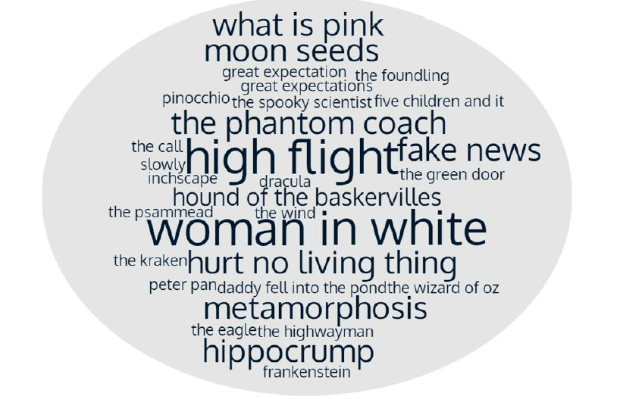
Choice of Units
Why do you use the units found in your planning?

Slide 14

Training
Training with the OD team
Mentors within school to cascade
Observations support less confident colleagues
How have you supported training through your school?

Slide 15
Supports deeper thinking
“Thinking out loud, asking questions and pondering is a crucial step to developing a viewpoint and being able to argue your point. This is developing critical thinking.”
“The conversations, which just wouldn't happen in a normal comprehension lesson around things as simple as set piece of punctuation, or the use of the word more than once. We go so much deeper than an answer in a SAT style question.”

Slide 16

The BIG How and Why: Enjoyment!
‘It gives me freedom’
‘I love the texts’
“I think it’s really interesting to teach something in a primary setting that is using skills that I was using at a degree level or certainly A- level capacity.”
The children enjoy it – not like other resources that ‘drain the life blood out of you’ – it’s not a checklist
How and why is Opening Doors enjoyed at your setting?

Slide 17

The Challenges
“I hear teachers say, ‘Oh, my children could never cope with that’. And really, it’s them who can’t cope with it.”
“ Our less confident teachers say it’s only for the greater depth children.
We’d like more non-fiction units
We’re de-colonising our curriculum
Workload

Slide 18
Moving forward …
How can we support subject knowledge and confidence?
How might units be embedded through a setting?
How might a network of OD schools support each other?
How can we maintain the enjoyment?

